Slide 1
Novel Support Vector Machines for Diverse Learning Paradigms
Gabriella Melki, PhD. Candidate, Virginia Commonwealth University
Advisor: Dr. Alberto Cano
Assistant Professor
Virginia Commonwealth University
Advisor: Dr. Sebastián Ventura
Professor
University of Córdoba
Notes:
Thank the committee for being here/remoting in from Spain, as well as everyone else who is attending. A big thanks to my family for flying in as well.
Today I’m going to present the work we’ve done for my PhD dissertation which is based on developing novel SVM…

Slide 2
Motivation
Large-scale learning
Memory capacity
Computational time
Extension to diverse paradigms
Multiple-Target Learning
Multiple-Instance Learning
Data Stream Learning
Our contributions aim to deal with these drawbacks by developing novel learning algorithms for Support Vector Machines.
Notes:
What is the motivation for the line of research?
For traditional machine learning, it stems from the tell-all case of solving large learning problems in a timely fashion
ML algorithms that scale with size of data:
Because dataset sizes have been growing so rapidly, there is a need for machine learning algorithms that are able to scale with the size of the data in terms of memory and time
More recently, traditional learning problems and methods have been extended to accommodate various emerging data representations which have given rise to new learning paradigms such as MTL, MIL, and DSL
Our contributions aim to tackle these learning problems while remedying the drawbacks of current methods that exist
Before going into details how we tackled these problems, I’d like to provide a brief description of the paradigms mentioned.

Slide 3
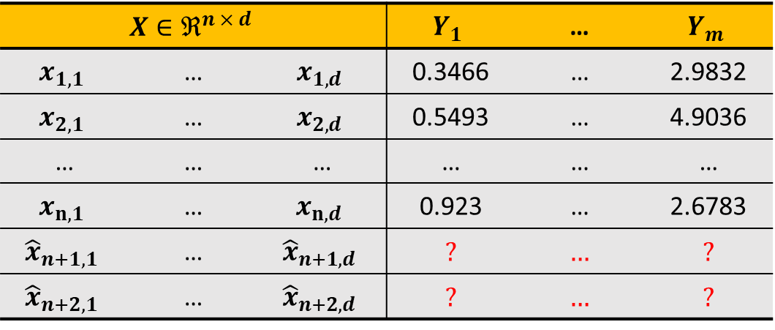
Multiple-Target Learning
Goal: build a model which predicts multiple possibly correlated outputs, or targets, simultaneously.
$$X∈ℜ^{n × d}$$ |  |  | $$Y_{1}$$ | … | $$Y_{m}$$
$$x_{1,1}$$ | … | $$x_{1,d}$$ | 0.3466 | … | 2.9832
$$x_{2,1}$$ | … | $$x_{2,d}$$ | 0.5493 | … | 4.9036
… | … | … | … | … | …
$$x_{n,1}$$ | … | $$x_{n,d}$$ | 0.923 | … | 2.6783
$${\hat{x}}_{n+1,1}$$ | … | $${\hat{x}}_{n+1,d}$$ | ? | … | ?
$${\hat{x}}_{n+2,1}$$ | … | $${\hat{x}}_{n+2,d}$$ | ? | … | ?
Training
Samples
Unknown
Samples
Inputs
Outputs
Notes:
First, we’ll begin with multiple target learning
Multi-target learning is a challenging task that consists of creating predictive models for problems with multiple outputs
Each sample is associated with more than a single output, or target as we can see from this toy dataset ***describe the data example***
Since the targets are produced by the same system, this implies that they might be correlated
Many types of multi-target learning
Multi-label classification
Multi-target regression
For the purpose of this work, we focus on MTR

Slide 4
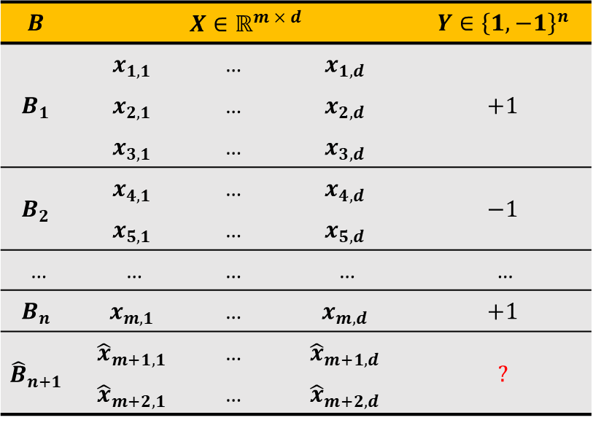
Multiple-Instance Learning
Goal: build a model which, given an unseen Bag containing multiple instances, will predict the bag’s label.
$$B$$ | $$X∈ℝ^{m × d}$$ |  |  | $$Y∈{\left\{1,−1\right\}}^{n}$$
$$B_{1}$$ | $$x_{1,1}$$ | … | $$x_{1,d}$$ | $$+1$$
 | $$x_{2,1}$$ | … | $$x_{2,d}$$
 | $$x_{3,1}$$ | … | $$x_{3,d}$$
$$B_{2}$$ | $$x_{4,1}$$ | … | $$x_{4,d}$$ | $$−1$$
 | $$x_{5,1}$$ | … | $$x_{5,d}$$
… | … | … | … | …
$$B_{n}$$ | $$x_{m,1}$$ | … | $$x_{m,d}$$ | $$+1$$
$${\hat{B}}_{n+1}$$ | $${\hat{x}}_{m+1,1}$$ | … | $${\hat{x}}_{m+1,d}$$ | $$\text{?}$$
 | $${\hat{x}}_{m+2,1}$$ | … | $${\hat{x}}_{m+2,d}$$
Training
Bags of instances
Unknown
Bag of instances
Notes:
MIL is a generalization of supervised learning, where a sample is considered a bag containing multiple instances associated with a single label ***Describe data while talking***
The instances in the bag are somehow related
The complexity in MIL is that we don't know the Individual labels within the bag - this makes it a form of semi-supervised learning
The only label that we know is the bag label - the way this label is assigned is dictated by some MI- Assumption
The goal is to build a model which, given an unseen BAG of instances, assigns the bag a label

Slide 5
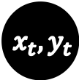
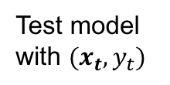
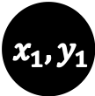
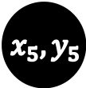
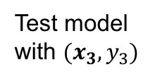
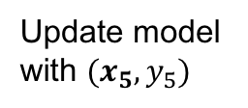
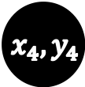
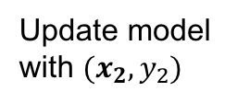
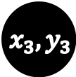
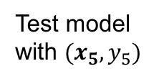
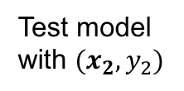
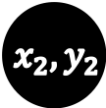
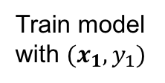
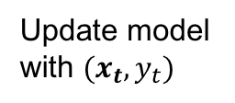
Data Stream Learning
Goal: build a model from continuously and possibly drifting arriving data, which predicts the output of unseen arriving samples.
$${ x}_{1}, y_{1}$$
$${ x}_{2}, y_{2}$$
$${ x}_{3}, y_{3}$$
$${ x}_{4}, y_{4}$$
$${ x}_{5}, y_{5}$$
… …
$${ x}_{t}, y_{t}$$
…
Train model with $(x_{1},y_{1})$
Update model with $(x_{2},y_{2})$
Update model with $(x_{5},y_{5})$
Update model with $(x_{t},y_{t})$
…
…
Test model with $(x_{2},y_{2})$
Test model with $(x_{3},y_{3})$
Test model with $(x_{5},y_{5})$
Test model with $(x_{t},y_{t})$
Notes:
In the context of supervised data stream classification
Goal: learn build a model from continuous and rapidly arriving data.
***Describe Data***
A data stream produces:
a rapid sequence of data from an unknown distribution,
over time that is possibly infinite in length,
and the data cannot be accessed more than once.
Due to this online scenario, typically once new data arrives the model is tested on the new sample, and then updated accordingly.

Slide 6
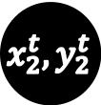
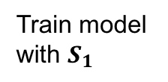
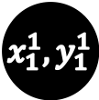
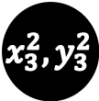
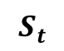
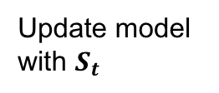
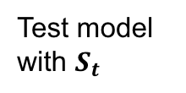
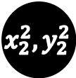
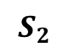

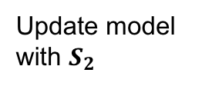
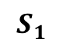
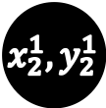
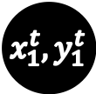
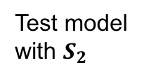
Data Stream Learning
Goal: build a model from continuously and possibly drifting arriving data, which predicts the output of unseen arriving batches.
$$S_{1}$$
$$S_{2}$$
$$S_{t}$$
$$x_{1}^{1},y_{1}^{1}$$
$$x_{2}^{1},y_{2}^{1}$$
$$x_{1}^{2},y_{1}^{2}$$
$$x_{2}^{2},y_{2}^{2}$$
$$x_{3}^{2},y_{3}^{2}$$
…
$$x_{1}^{t},y_{1}^{t}$$
$$x_{2}^{t},y_{2}^{t}$$
Update model with $S_{2}$
Update model with $S_{t}$
Train model with $S_{1}$
Test model with $S_{2}$
Test model with $S_{t}$
Notes:
Batches
Method of testing and updating the model stays the same
A complexity: (that can arise from this type of learning is that the )
data’s distribution can also change over time - concept-drift.
This is a characteristic of the time element of data stream learning
Older data can become obsolete as time goes on
Because of this, algorithms need to be:
robust
alert
perform classification in a resource adaptive way.
Given these learning paradigms, we now move on to our contributions

Slide 7
Contributions
Multi-Target support vector regressors using maximum correlation chains:
Support Vector Regressor (SVR)
Ensemble of Randomly Chained SVRs (SVRRC)
SVR using a single Maximally Correlated Chain (SVRCC)
Multi-Instance SVM bag-level formulation and algorithm:
Multi-Instance Representative SVM (MIRSVM)
Online, i.e. stochastic, SVM with novel stopping criterion & update
OnLine Learning Algorithm using Worst-Violators (OLLAWV)
Data Stream support vector machines for batched streams
OnLine Learning Algorithm - List 2 (OLLA-L2) & OLLAWV
Notes:
The contributions of this dissertation are categorized into 4 groups
The first falling under the MTR paradigm
3 novel SVRs are designed for MTR based on the idea of target chaining
The second falls under the MIC paradigm
A novel SVM bag-level formulation + and algorithm
The third is a unique stochastic SVM algorithm which has a novel update procedure and stopping criterion. This would later be used for the fourth and final contribution:
The implementation of the OLLAWV, as well as its predecessor, under a batched stream scenario.

Slide 8
Agenda
Background
Support Vector Machines
NN & SVMs: Form vs. Norm
SVM Solvers
Contributions
Multi-Target SVR using Max Correlation Chains
Multi-Instance SVM using Bag Representatives
Novel OnLine SVM using Worst-Violators
OLLAWV for Batched Data Streams
Conclusions
Future Work
Background
Algorithm
Experimental Environment
Results & Statistical Analysis
Conclusions
Notes:
First I will give a short background on SVMs & why they are important
Then we’ll move on to discuss the contributions
Each will have a short background / algorithm / …
After that we’ll give some overall conclusions
And possibility for future work
Then at the end we will take questions, but please feel free to stop me if something comes up.

Slide 9
Background

Slide 10
Support Vector Machines (SVM)
SVMs have been developed in order to target modern machine learning problems, particularly learning from high dimensional & sparse data.
This has been achieved by introducing novel cost function.
Well, what is the novel cost function and why is it so attractive?
Notes:
SVMs represent popular linear and non-linear learning algorithms that have been developed to target modern machine learning problems:
Learning from high-dimensional & sparse data
They are known for creating sparse and non-linear classifiers, making them suitable for handling large datasets.

Slide 11
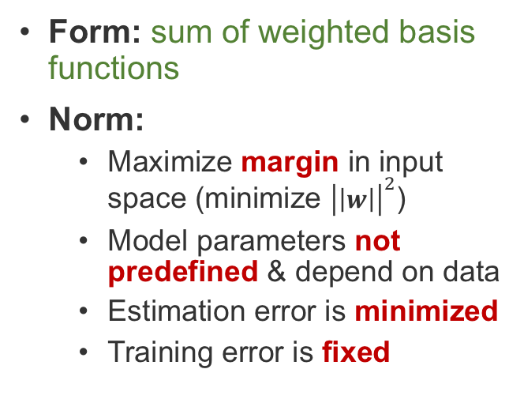
NN & SVMs: Form vs. Norm
Classic Approach by NN
Support Vector Machines
Form: sum of weighted basis functions
Norm:
Minimize sum of errors squared in output space
Model parameters predefined before training
Estimation error remains fixed
Training error is minimized
Form: sum of weighted basis functions
Norm:
Maximize margin in input space (minimize ${\left|\left|w\right|\right|}^{2}$)
Model parameters not predefined & depend on data
Estimation error is minimized
Training error is fixed
Notes:
Let's first illustrate the attractiveness of SVMs by comparing them to classic approaches like that of NN by looking at their form and norm
Form - as with majority of algorithms, is the same
Norm - different (cost functions) & how they learn function parameters
e.g. NN minimize sum of errors squared in output space
not efficient for large scale learning
SVM maximize margin in input space - min norm of w
Robust to very large number of variables and small samples
Model parameters
Training error fixed
Can learn both simple and highly complex classification models, while being good generalizers

Slide 12
Support Vector Machines
Classification
Regression
Hinge Loss
Epsilon-Insensitivity Loss
Notes:
So now let's take a look at this cost function
The goal is to learn a classifier, that maximizes the margin of separability between classes while minimizing the loss or error. This is a QP problem
Show loss functions
Both loss functions are key to the SVMs model sparsity.
The margin is maximized by minimizing the norm of w, as mentioned previously
Here C controls the tradeoff of margin maximization and error minimization.
If such linear decision surface does not exist, the data is mapped into a much higher dimensional space (“feature space”) where the separating decision surface is found, using the kernels.
REGRESSION
The support vector machine was applied to the regression case, maintaining all the maximal margin algorithmic features.
Now that we’ve introduced the SVM problems, this brings us to how to solve them.

Slide 13
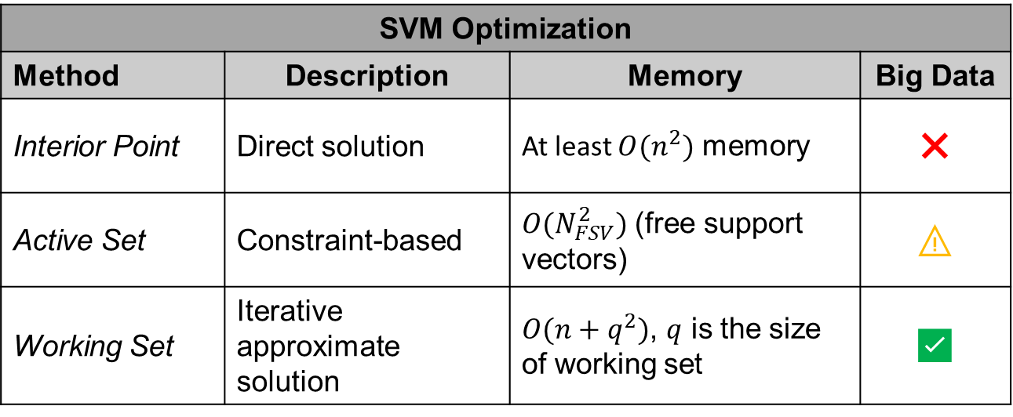
Solving the SVM Problem
SVM Optimization
Method | Description | Memory | Big Data
Interior Point | Direct solution | At least $O(n^{2})$ memory | ❌
Active Set | Constraint-based | $O(N_{FSV}^{2})$ (free support vectors) | ⚠️
Working Set | Iterative approximate solution | $O(n+q^{2})$, $q$ is the size of working set | ✅
Notes:
The challenge of applying SVMs on huge data sets:
The amount of computer memory required for solving the QP problem presented in the previous slide increases drastically with the size of the training data set n.
Depending on the memory requirement, the solvers can be classified into 3 groups:
Interior point
Can directly find solution but require O[n^2] memory requirements (runtime of O[n^3])
Often used for small sized problems that require high precision
Active set
Between two ends of the spectrum are active set methods with memory requirements of O[N^2]
Their performance really depends on the NSV
Working set
(Decomposition) methods, require O[n + q^2] – reason is because solution is found iteratively instead of directly
Only possible algorithms for large scale problems
SMO is by far the most popular and widely used method in this category, but it is highly dependent on the SVM hyperparameters.
Descent methods (coordinate or stochastic) are also popular because of their fast convergence rates. (sub-linear)
Given these popular approaches, we first opted to apply existing solvers to the emerging learning paradigms mentioned previously.
However, we also decided to develop our own solver to further improve SVM performance on large-scale data

Slide 14
Multi-Target SVR using Maximum Correlation Chains
Notes:
Now, we will present our 3 contributions for the multi-target regression learning paradigm based on the idea of building chained regressors.
First, I'll give a brief background on some methods for solving this paradigm, then we will dive into the technicalities of the contributions

Slide 15
Multi-Target Regression
Approach | Methods | Targets’ Relationships Exploited | Run Time | Accuracy
Problem Transformation | Single Target | ❌ | ⚠️ | ✅
 | MTR Stacking | ⚠️ | ⚠️ | ⚠️
 | Regressor Chains | ⚠️ | ⚠️ | ⚠️
Algorithm Adaptation | Statistical methods | ✅ | ⚠️ | ⚠️
 | Kernel methods | ✅ | ⚠️ | ⚠️
 | MTR Trees | ✅ | ✅ | ✅
✅ - good performance
⚠️ - dependent on # of targets & their correlations (if exist)
❌ - poor performance
Notes:
The biggest issue with MT learning lies in the data's outputs:
Whether the outputs are correlated
and if so, how to capture & exploit them in the learning model?
There are 2 main approaches to doing this:
problem transformation
Problem transformation methods involve altering the MT problem into ST ones.
Base-line algorithm is the ST one, so far, the best in its group
DOWN TO AL ADAPT
The way PT methods try and exploit correlations is though
Stacking – 2-stage learning
The method we’ll focus on is Chaining:
We were inspired by a regression algorithm that uses chaining called ERCC:
The whole idea behind chaining is to use knowledge gained by each target to predict the remaining targets, sequentially.
Use this in conjunction with SVMs.
algorithm adaptation
Algorithm adaptation methods involve modifying existing traditional algorithms to predict all the target variables simultaneously.
Most valuable advantage is that relationship amongst targets exploited
Issue: if target uncorrelated, ST is better

Slide 16
Base-Line Multi-Target SVR
Notes:
First, we will describe the base model for our experiments:
where m single-target non-linear support vector regressors (NL-SVR) are built for each target variable Yj
Describe figure:
Dataset is first split into m different sets
Build SVR for each set
The reason behind this method:
Evaluate the performance of ST-SVM against the other SOA methods
Evaluate it as a base-line method for the purpose of observing the improvements of our chained methods against a ST method

Slide 17
SVR with Random Chains (SVRRC)
Notes:
This brings us to our second contribution, inspired by ERCC, SVRRC.
Describe
Here the dataset is not split
Using a chain, it is augmented by incrementally by adding the true target values as input to predict the next target in the chain
First, a chain of the outputs’ indices is created
Then, a regressor is incrementally built to predict the next target in the chain
This is an ensemble method which builds at most 10 randomly chained models, as done in ERCC. (4 targets > 10 chains)
[Difference between us and ERCC]
In ERCC, their chained model consists of chaining the predicted target values from the previous step, for SVRRC, we opted against that and used the true target outputs in order to minimize error propagation during the chaining process
This method was fine, but we worried that that randomly generated chains might not maximally capture the target’s correlations. That brings us to our next proposal.

Slide 18
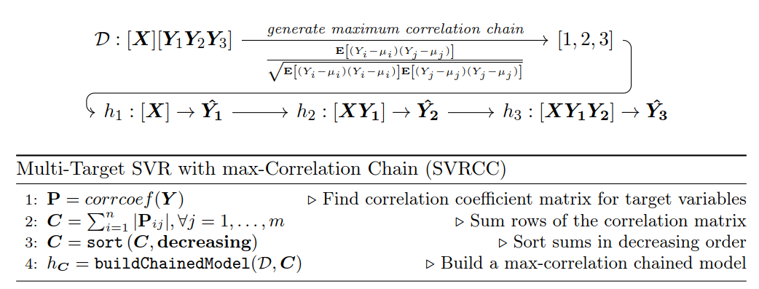
SVR max-Correlation Chain (SVRCC)
Notes:
This contribution builds a single chained regressor in the direction of maximum correlation among the target variables
The idea:
Build single chain, rather than an ensemble of 10, in direction of max corr
This ensures that using the target as input for the next positively contributes towards learning
Steps:
We first calculate the correlation coefficient matrix for the target variables,
take the row-wise sum of absolute value,
sort them in decreasing order, and
use the indices as the max-corr chain

Slide 19
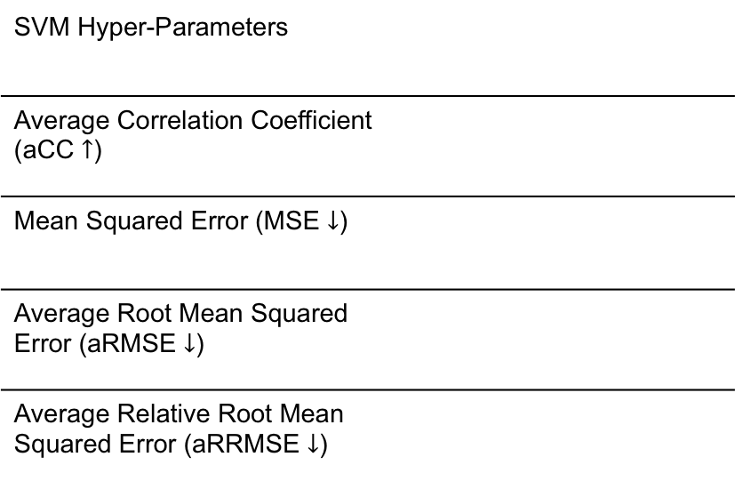
Experimental Environment
SVM Hyper-Parameters
Average Correlation Coefficient (aCC $↑$)
Mean Squared Error (MSE $↓$)
Average Root Mean Squared Error (aRMSE $↓$)
Average Relative Root Mean Squared Error (aRRMSE $↓$)
Notes:
Developed our novel SVRs in java within the MULAN’s framework, which was built on top of WEKA
We chose popular methods from the same framework to ensure a controlled environment with the authors' recommended parameters
The following are the metrics used & parameters
For the sake of time we will report
ARRMSE
Run time
Rigorous statistical analysis was also performed but for the sake of time, we will only report the bonf-dunn with critical difference value with 95% confidence
-----
The ST base-line model used was Bagging of 100 regression trees.
The MTSC and ERCC methods are run using 10-fold cross-validation, and the ensemble size for the ERC and ERCC methods was set to 10.
The ensemble size of 100 trees was used for MORF, and the rest of its parameters were set as recommended by Kocev et al. “Tree ensembles for predicting structured outputs”. In: Pattern Recognition 43 (2013), pp. 817–833.

Slide 20
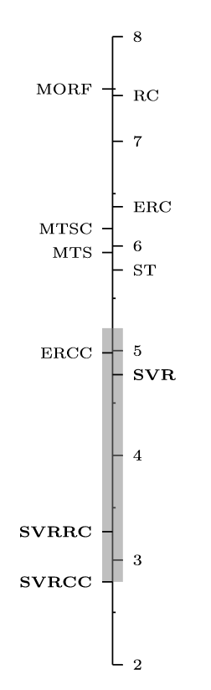
Results
Notes:
The table shows the results for the first metric & algorithm ranks, and the figure on the right is the Bonferroni dunn bar.
Maybe describe the figure and how BF works?
All proposals 17 out of the 24 datasets
SVR performs the best on 1 / 17
SVRRC 5 / 17
SVRCC performs the best on 11 / 17
These results complement our initial hypothesis that chaining does in fact improve the performance of the classifier

Slide 21
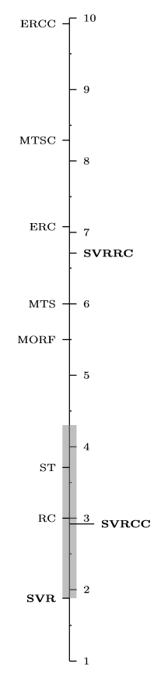
Results
Notes:
Here the results indicate that the ST methods & single RC are the fastest, which makes sense because they are neither ensembles, stacked, or chained classifiers.
Talk about how SVRCC is competitive against the ST methods
No time is lost building the chain
Only one chain so it's like RC
Competitive in time against ST
Show that ERCC is the last
Not only is it competitive in terms of performance, but it is also competitive in terms of time

Slide 22
Multi-Target Regression Conclusions
SVR – Results show SVR’s superior performance as a base-line model, rather than regression trees, as used in MORF.
SVRRC – Results highlighted the importance exploiting relationships among the target variables during training.
SVRCC – Results show it’s superiority:
Ranked the first in all quality metrics & second best in terms of run time.
SVRCC performed better than SVR & SVRRC.
This shows that the targets’ maximum correlation does positively contribute toward model training.
Notes:
To conclude:
SVR showed great performance as a base-line model
SVRRC highlighted exploiting targets relationships
SVRCC
Ranked 1st for quality metrics and 2nd in terms of run time
Better than SVRRC and SVR

Slide 23
Multi-Instance SVM using Bag Representatives
Notes:
Now I would like to present our contribution towards the Multiple-Instance learning paradigm, a MI SVM for classification using bag-representatives

Slide 24
Multi-Instance Classification
Paradigms
Instance Space
Bag Space
Embedded Space
Collective assumption
Standard MI assumption
Distance between bags
Vocabulary based
Not Vocabulary based
✅ bags contain large number of instances
❌ bags of different classes contain similar instances
❌ bags contain large number of instances
✅ bags of different classes contain similar instances
Notes:
As mentioned previously, in MIL, samples are considered bags, which contain multiple instances, and each bag is associated with a label.
The biggest complexity associated with MIL is that the individual labels of the instances are unknown.
There are several approaches to dealing with this problem which fall into 3 categories:
Instance Space
Separate instances in positive bags from those in negative
Bag label found by aggregating instance-level scores using some kind of assumption
Works best when bags contain a large number of instances
Bad when bags of differing classes contain similar instances
Bag Space
Treat each bag as a while entity, use distance metrics to extract info from each bag
Non-vector space, so they use distance functions or kernels
Embedded Space
Each bag is mapped to a single input vector summarizing relevant information about the whole bag
Vocab
Aggregates stats of all instances within bag
Non Vocab
Analyze how instances in each bag match certain prototypes previously discovered in data
Both Bag & Embedded exploit bag-level information as a whole
Difference is that bag space is done implicitly through a kernel function and embedded is an explicit transformation through a mapping function (performance really depends on mapping function)

Slide 25
Multi-Instance Classification
Paradigms
Instance Space
Bag Space
Embedded Space
Collective assumption
Standard MI assumption
Distance between bags
Vocabulary based
Not Vocabulary based
✅ bags contain large number of instances
❌ bags of different classes contain similar instances
❌ bags contain large number of instances
✅ bags of different classes contain similar instances
Notes:
The scope of this work surrounds to SMI
The SMI Assumption states that… ***Animation***

Slide 26
Multi-Instance Classification
Paradigms
Inspired by MI-SVM (Andrews et. al.)
Mixed-integer QP problem
Solved heuristically using positive bag-representatives
✅ When positive bags contain a sparse number of positive instances
❌ Class imbalance with representatives
Instance Space
Bag Space
Embedded Space
Collective assumption
Standard MI assumption
Distance between bags
Vocabulary based
Not Vocabulary based
✅ bags contain large number of instances
❌ bags of different classes contain similar instances
❌ bags contain large number of instances
✅ bags contain several classes of instances
Notes:
For our approach, we were inspired by MISVM, proposed by Andrews et. al:
It is a mixed-integer quadratic program that solves the MI problem at an instance-level, using a support vector machine, & is solved heuristically.
It tries to identify the key instance from each positive bag that makes the bag positive by assuming it has the highest margin value.
At most one instance from positive bags are selected as bag-representatives, and the algorithm iteratively creates a classifier that separates those representatives from all those in negative bags.
Disadvantage:
Creates a class imbalance problem where SVs from negative class are more prominent
The way we aimed to remedy this class imbalance problem is to restrict the instances in the negative class as well.

Slide 27
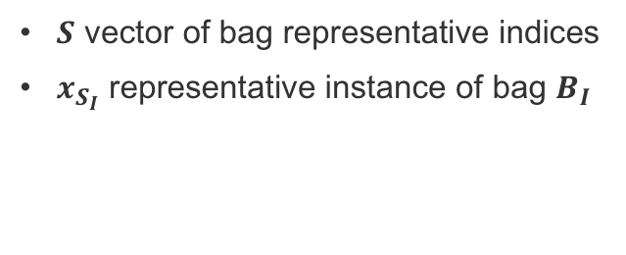
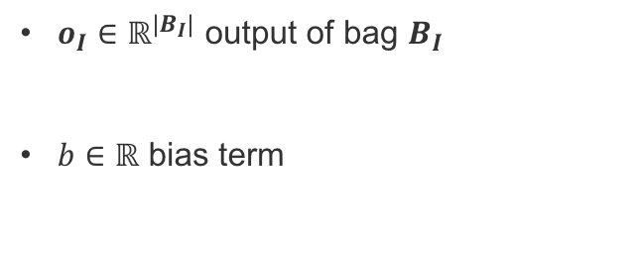
MIRSVM: Formulations
Primal
Dual
$S$ vector of bag representative indices
$x_{S_{I}}$ representative instance of bag $B_{I}$
$o_{I}∈ℝ^{|B_{I}|}$ output of bag $B_{I}$
$b∈ℝ$ bias term
G. Melki et al. “MIRSVM: Multi-Instance Support Vector Machine with Bag Representatives”. Pattern Recognition, vol. 79, 228-241, 2018
Notes:
MIRSVM is based on the idea of selecting representative instances from both positive and negative bags which are used to find an unbiased, optimal separating hyperplane.
What we did was first reformulate the L1-SVM problem to optimize over bags rather than instances, as shown
A representative is iteratively chosen from each bag, and a new hyperplane is formed according to these new selected representatives until they converge.
Based on the SMI hypothesis, only one instance in a bag is required to be positive for the bag to adopt a positive label.

Slide 28
MIRSVM: Formulations
Primal
Dual
$S$ vector of bag representative indices
$x_{S_{I}}$ representative instance of bag $B_{I}$
$o_{I}∈ℝ^{|B_{I}|}$ output of bag $B_{I}$
$b∈ℝ$ bias term
G. Melki et al. “MIRSVM: Multi-Instance Support Vector Machine with Bag Representatives”. Pattern Recognition, vol. 79, 228-241, 2018
Notes:
In other words, the most positive instance is chosen from each positive bag and the least negative instance is chosen from each negative bag (instances with the largest output value based on the current hyperplane)
These representatives are stored in SI
what we opted to do is derive and solve the dual problem using a QP solver

Slide 29
MIRSVM: Algorithm
Notes:
First we initialize the representatives randomly
then...

Slide 30
Comparison of MIRSVM and MISVM
Notes:
To illustrate the difference between our method and MISVM, Here we have 2 comparison plots of the decision boundaries produced by both algorithms on a toy dataset.
The two methods were built on the same SVM hyper parameters.
the major differences in the final models.
The dark x’s represent instances that are chosen as support vectors
As we can see, MISVM has many more in the negative class, pushing the decision boundary towards that of the positive class
Since MIRSVM limits the number of representatives from the negative bags as well, it produces a sparser & more balanced model than MISVM

Slide 31
Experimental Environment
SVM Hyper-Parameters
Accuracy
Precision
Recall
Cohen’s Kappa Rate
Area Under ROC Curve
Notes:
The main aim of the experiments is to compare our contribution to other MI SVMs, and contemporary multi-instance learners
Datasets from Weka and KEEL dataset repositories.
These algorithms were chosen because they have shown considerable performance in learning multi-instance models, while also having their frameworks readily available for reproducing their results through MILK, the Multi-Instance Learning Kit, used in conjunction with the Weka framework.
------
Instance-level methods include MIOptimalBall, MIBoost, MISVM, MIDD, and MIWrapper.
Bag-level methods include MISMO, SimpleMI, miGraph, and TLC.
The ensemble-based bag-space methods, Bagging and Stacking, were also used.

Slide 32
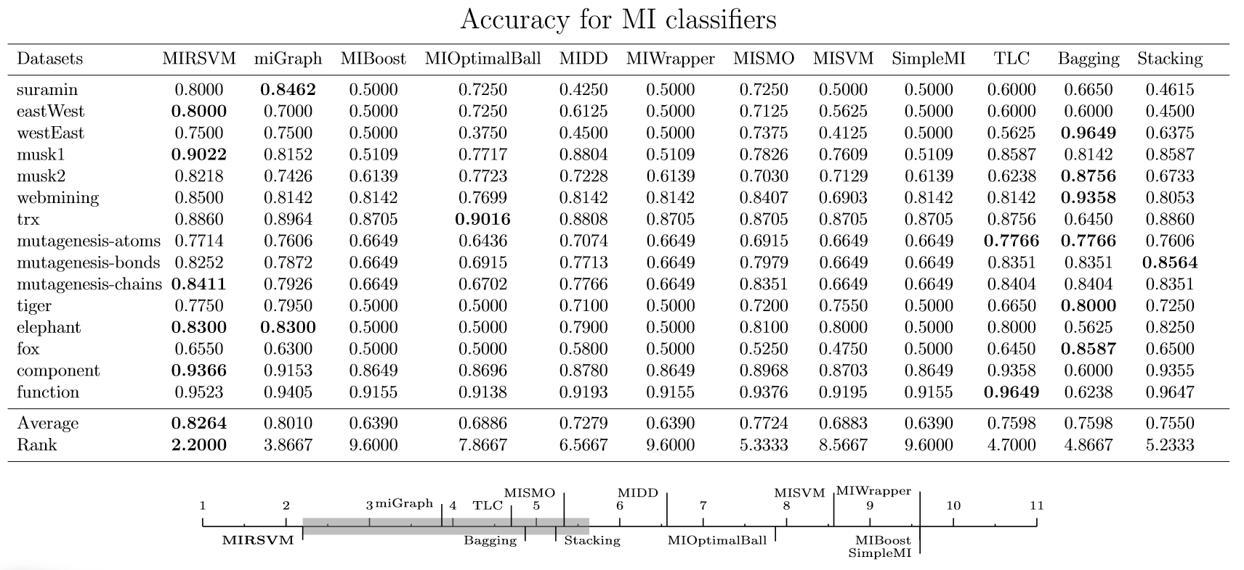
Results
Notes:
Bag-based and ensemble learners perform better than the instance-based and wrapper methods:
MIBoost, MIWrapper, and SimpleMI
This behavior emphasizes the importance of not making prior assumptions about the positive bags’ distributions.
Also note that MIRSVM performs better than MISVM for all datasets, indicating that using a single representatives from each bag improves the classification performance.

Slide 33
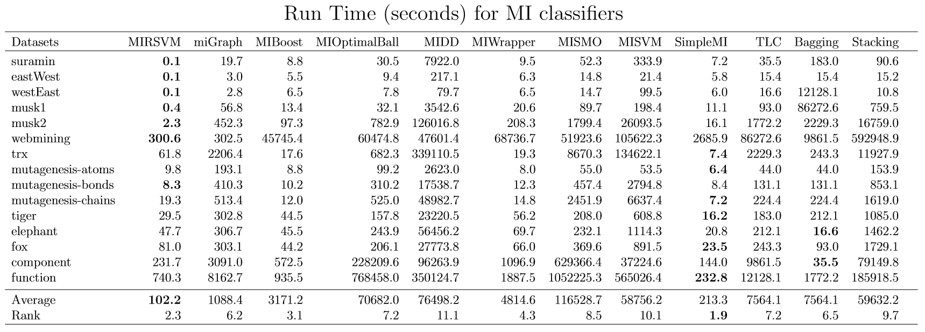
Results
Notes:
MIRSVM has the fastest run time and is ranked second.
MIRSVM shows very good scalability considering the number of features, such as in the webmining dataset which comprises of 5863 attributes.
It is important to note that quadratic programming solvers are not the most efficient tools for solving optimization problems in terms of run time, and yet MIRSVM still is shown to perform competitively against the current widely used algorithms. The scalability of MIRSVM is founded on the speedy rate of bag-representative convergence.
SimpleMI achieves the highest rank and competitive run times because, rather than use the instances in each bag to train a model, it takes the mean value of the instances in a bag and uses that for training.
Even though SimpleMI has fast run-times, its performance over the previous metrics has been shown to be random and not as effective.

Slide 34
Multi-Instance Classification Conclusions
MIRSVM – Results show the better performance of MIRSVM, overall:
Outperformed MISVM & MISMO
Bag-representative selector: remedied class imbalance resulting in improved accuracy
Fast convergence
Statistical analysis showed that:
bag-level based & ensemble learners had the best performance
instance-level based learners performed poorly in comparison or were deemed as strongly biased and unstable classifiers
MIRSVM performs statistically better, neither compromising accuracy nor run time while displaying a robust performance across all datasets.

Slide 35
Online SVM using Worst-Violators
G. Melki et al. “OLLAWV: OnLine Learning Algorithm using Worst-Violators”. Applied Soft Computing, vol. 66, 384-393, 2018
Notes:
Because of limitations presented by popular SVM solvers, we opted to design our own novel online, i.e. stochastic, SVM.

Slide 36
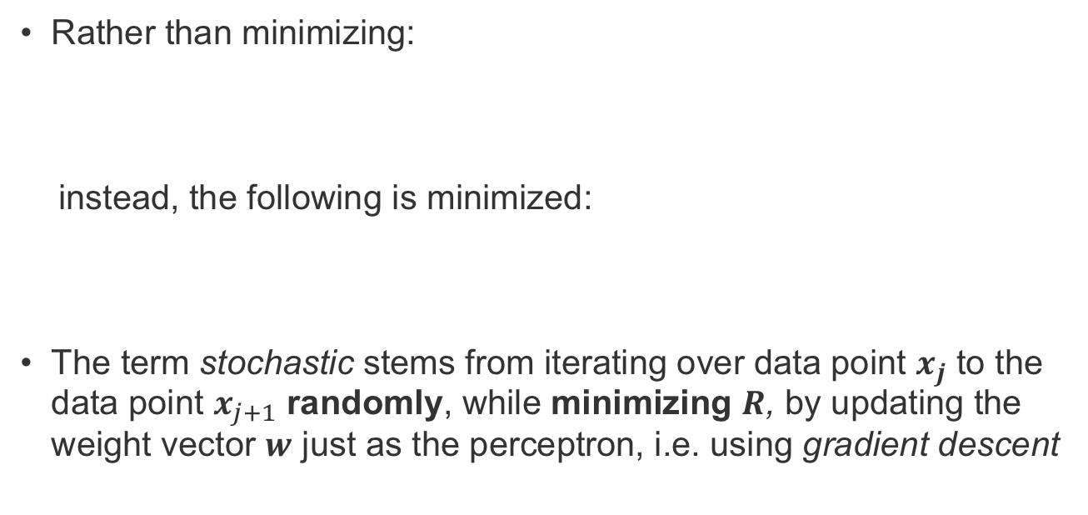
Online, i.e. Stochastic, Learning
Rather than minimizing:
instead, the following is minimized:
The term stochastic stems from iterating over data point $x_{j}$ to the data point $x_{j+1}$ randomly, while minimizing $R$, by updating the weight vector $w$ just as the perceptron, i.e. using gradient descent
G. Melki et al. “OLLAWV: OnLine Learning Algorithm using Worst-Violators”. Applied Soft Computing, vol. 66, 384-393, 2018
Notes:
For stochastic, or online, learning
Rather than minimizing the following
We minimize this
Stochastic means …

Slide 37
Online, i.e. Stochastic, Learning
Stochastic Gradient Descent
Primal Optimization
Similar to the perceptron algorithm, but non-linear
Early stopping → control margin size
Advantages
Disadvantages
✅ Simple implementation
✅ Computationally efficient when reaching predefined risk
❌No meaningful stopping criterion
❌Computationally complex when number of samples too large
G. Melki et al. “OLLAWV: OnLine Learning Algorithm using Worst-Violators”. Applied Soft Computing, vol. 66, 384-393, 2018
Notes:
SGD methods have also been used to solve the primal soft margin SVM problem & are similar to perceptron
Cycles repeatedly, updating only if there is an error
By cycling, these algorithms can process large amounts of data at faster speeds with lower memory resources
Continues to update until user intervenes
Disadvantage
SGD methods are similar, but fundamentally different, to mistake driven perceptron, which stops training when no errors are found
Kivinen et al. showed that it can be computationally expensive to train SVMs and perceptrons using SGD due to the regularization term, i.e. the term that controls the models capacity, and then showed alternative methods for remedying this issue.
Namely, early stopping, and the removal of the regularization term or the learning rate, can control the size of the margin.
However, this then raises the question about knowing when it is early enough to stop.
it was also shown that using SGD in the primal provides better solution than optimizing in the dual
These are the two reasons that inspired the investigation for OLLAWV.
Note: empirical risk is the training error and expected risk is true error

Slide 38
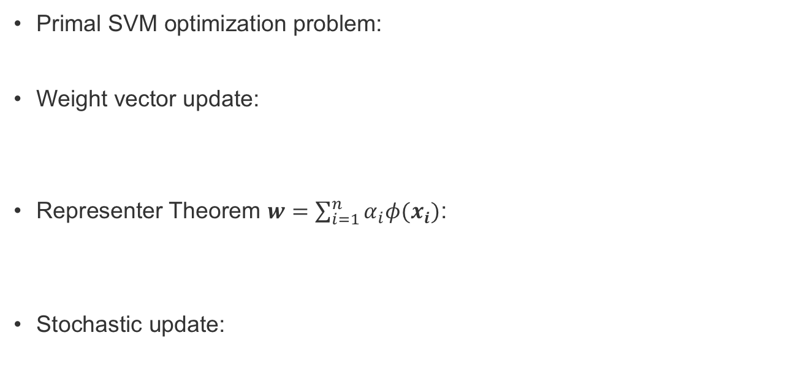
OLLAWV: Formulation
Primal SVM optimization problem:
Weight vector update:
Representer Theorem $w=\sum_{i=1}^{n}{α_{i}φ(x_{i})}$:
Stochastic update:
G. Melki et al. “OLLAWV: OnLine Learning Algorithm using Worst-Violators”. Applied Soft Computing, vol. 66, 384-393, 2018
Notes:
OLLAWV performs stochastic gradient descent on the primal L1-SVM objective function.
Novel update procedure
Self-stopping condition
Now I’ll briefly describe the algorithm derivation:
First we take the derivative with respect to w
From the representer theorem, we replace with the following
From a stochastic update, sample by sample, the update becomes…
Which states, if there is an error, update with the following, and if no error is found, update with this.

Slide 39
OLLAWV: Formulation
Primal SVM optimization problem:
Weight vector update:
Representer Theorem $w=\sum_{i=1}^{n}{α_{i}φ(x_{i})}$:
Stochastic update:
Updates worst-violating sample only
Worst-violator updated once
G. Melki et al. “OLLAWV: OnLine Learning Algorithm using Worst-Violators”. Applied Soft Computing, vol. 66, 384-393, 2018
Notes:
Now, the difference, novelty, and advantage of OLLAWV with respect to other SGD methods resides in the way it iterates:
where the weight $\alpha_i$ of the most violating sample is only updated in each iteration.
A worst violating sample is defined as the sample that has the largest error with respect to the current hyperplane.
Rather than randomly selecting a sample to update per iteration, OLLAWV selects (without replacement) the most incorrectly classified sample and updates the model accordingly.
Since it updates worst violator only, this condition is never satisfied
And since it is without replacement, this term is always –
So the update becomes
By iteratively updating the model using only the worst-violator, the model is essentially finding its support vectors, as well as implicitly defining a stopping criterion.
If there are no more violating samples, the algorithm terminates, eliminating the need to set the number of iterations for an algorithm to perform, as is the case with most contemporary online algorithms.

Slide 40
OLLAWV: Algorithm
G. Melki et al. “OLLAWV: OnLine Learning Algorithm using Worst-Violators”. Applied Soft Computing, vol. 66, 384-393, 2018

Slide 41
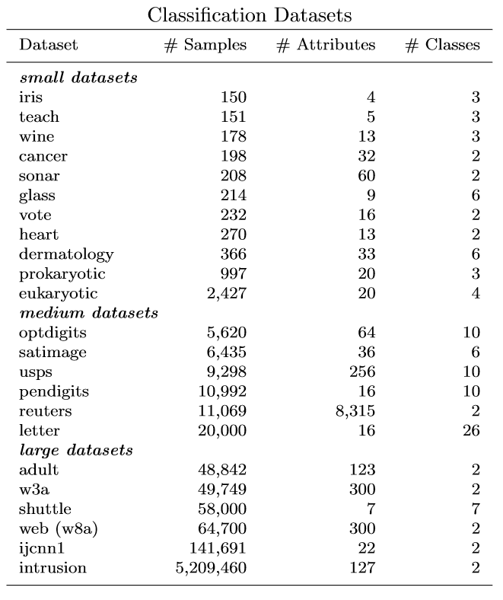
Experimental Environment
Nested Cross-Validation (5 inner and 5 outer folds)
Metrics: Accuracy, Run Time, Support Vectors
G. Melki et al. “OLLAWV: OnLine Learning Algorithm using Worst-Violators”. Applied Soft Computing, vol. 66, 384-393, 2018
Notes:
2 experimental setups were conducted:
SVM
non-SVM
SVM:
NNISDA vs. MNSVM
Both have shown to have better performance than SMOs implementation in LIBSVM
Controlled Experimental Env
All were implemented in C++ in a framework called GSVM - Command Line Tool for Geometric SVM
Same Machine
Same hyperparameters
Pairwise approach: c(c - 1)/2
Non-SVM:
Chose those algorithms because competitive and popular + available for use in Weka
Implemented in Java
Both environments:
Strict nested 5 fold CV
It ensures the class labels of the test data will not be seen when tuning the hyperparameters, which is consistent with real-world applications.
Linear transformation of features to range [0,1]

Slide 42
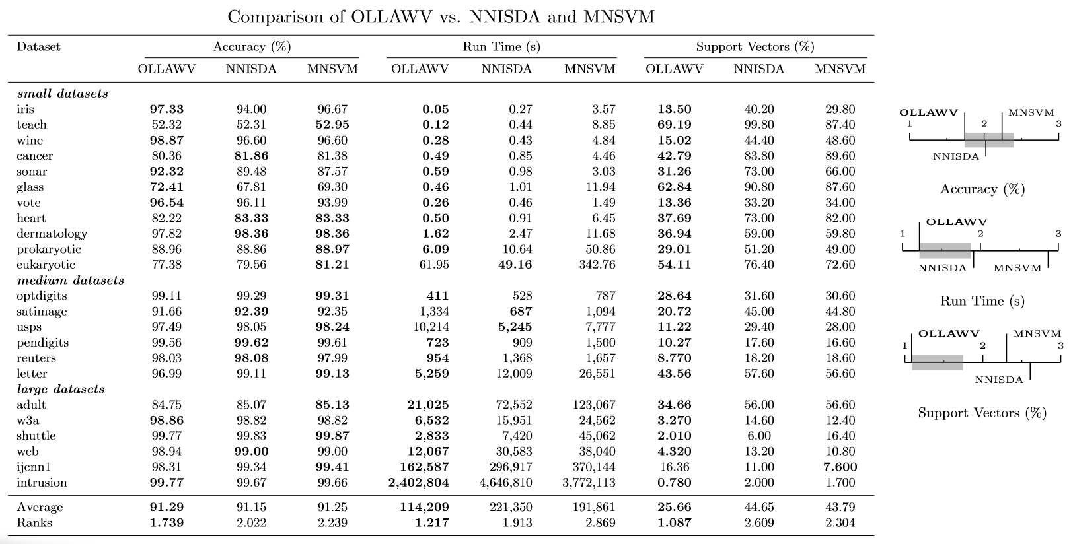
SVM Comparison Results
G. Melki et al. “OLLAWV: OnLine Learning Algorithm using Worst-Violators”. Applied Soft Computing, vol. 66, 384-393, 2018
Notes:
The results in the Table indicate that OLLAWV outperforms NNISDA and MNSVM in terms of accuracy, run time, and model complexity.
Although the differences in accuracy between the methods is not very large, on average, OLLAWV is about $2$ times faster than NNISDA and MNSVM.
As mentioned previously, OLLAWV aims to speed up the learning process without sacrificing the model's accuracy. This stems from OLLAWV's ability to produce sparse models, as is shown by the averaged percentage of support vectors.
The speedup that OLLAWV presents is proportional to the model complexity and the experimental results show that OLLAWV produces, on average, models that are $1.7$ times smaller than the two state-of-the-art methods used. This highlights the applicability and advantage that OLLAWV has for learning from large datasets.
Bonf Figures show the results of the statistical analysis for accuracy, run time, and percentage of support vectors. Figures CPU and SV show that OLLAWV is statistically significantly better than MNSVM and NNISDA for run time and percentage of support vectors (model size). At the same time, Figure ACC emphasizes what was mentioned earlier: OLLAWV is shown to speed up the learning process without sacrificing model accuracy against the popular methods used.

Slide 43
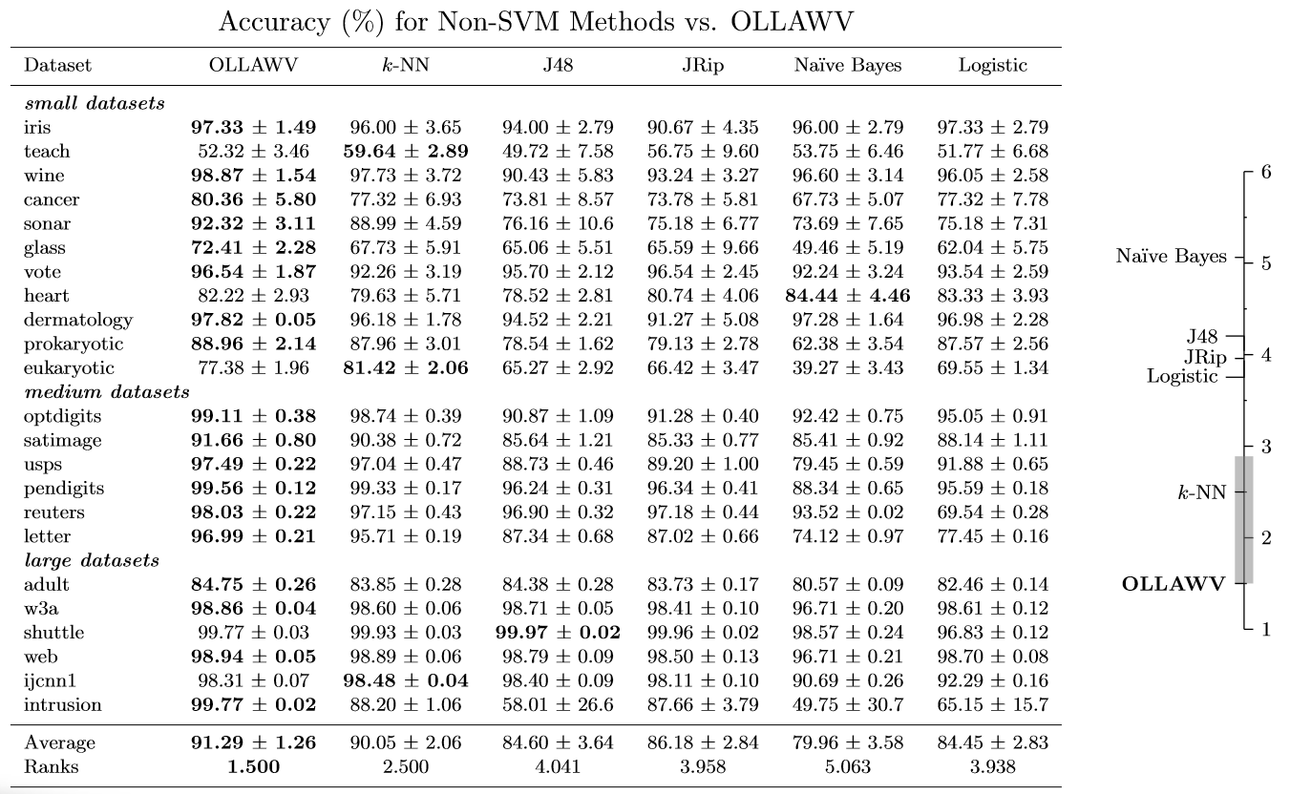
Non-SVM Comparison Results
G. Melki et al. “OLLAWV: OnLine Learning Algorithm using Worst-Violators”. Applied Soft Computing, vol. 66, 384-393, 2018
Notes:
Table displays the accuracy results for all algorithms, standard deviation for accuracy per outer fold
As the results indicate, OLLAWV outperforms all other methods.
The statistical analysis shows that OLLAWV performs significantly better than the competing methods for $\alpha = 0.05$ and is ranked first, except for KNN

Slide 44
OLLAWV Conclusions
Competitive accuracy with SVM and non-SVM methods.
Significant decrease in run time.
Significant decrease in model complexity.
G. Melki et al. “OLLAWV: OnLine Learning Algorithm using Worst-Violators”. Applied Soft Computing, vol. 66, 384-393, 2018
Notes:
A novel online learning procedure and algorithm for solving the L1-SVM problem:
Unique method in terms of both iterating over samples
Updating the model
Novel stopping criterion
Such an approach results in a significant shortening of training time, as well as in a huge decrease in the resulting model size.
The key features of the proposed algorithm, OLLAWV, stem from its implicit ability of finding support vectors and its self-stopping condition.
All these features of OLLAWV resulted in:
Competitive accuracy against all methods
Significant decrease in runtime
Significant decrease in model complexity

Slide 45
OLLAWV for Batched Data Streams

Slide 46
Data Stream Classification
Data Stream Learning
Stationary
Batch
Online
Non-Stationary
Batch
Stream Type
Learning
Mode
Online
Requirements:
Incremental Processing
Limited Time
Limited Memory
Changes in Data
Notes:
In the context of supervised stream classification, build a model from continuous rapidly arriving data
Can arrive in batch or online format
This calls for machine learning algorithms that can:
Incrementally process the rapidly arriving data
In a short amount of time
And can function with limited memory consumption
Not only that, the data’s distribution can change over time as well ***NEXT***

Slide 47
Data Stream Classification
Data Stream Learning
Stationary
Batch
Online
Non-Stationary
Batch
Stream Type
Learning
Mode
Online
Requirements:
Incremental Processing
Limited Time
Limited Memory
Changes in Data
Notes:
Which brings us to the two main types of streams
Stationary:
Non-stationary: Distribution of data changes over time
Abrupt
Gradual
This also adds a requirement where algorithms to be robust, fast, adaptive.

Slide 48
Data Stream Classification
Data Stream Learning
Stationary
Batch
Online
Non-Stationary
Batch
Stream Type
Learning
Mode
Online
Approach
Active
Passive
Notes:
2 main approaches to tackling the non-stationary case
Active
Relies on change detection mechanism to trigger an update to remedy or react to the change encountered
Passive
Perform continuous updates to the model whenever new data arrive

Slide 49
Data Stream Classification
Data Stream Learning
Stationary
Batch
Online
Non-Stationary
Batch
Stream Type
Learning
Mode
Online
Approach
Active
Passive
Change Detection
Adaptation
Single
Ensemble
Notes:
Under Passive approaches, one could use: (depending on the application)
Single classifiers
Usually more attractive and simple solution for mining large data streams
Ensemble classifiers
Very popular due to their natural way of handling drifting streams
Active
Change detection
Difficult for gradual drifts
Better when more abrupt
Small disadvantage that if the drift detector makes a mistake, could be catastrophic for the model
Adaptation
Once a change is detected, algorithm needs to adapt
Difficult to distinguish between obsolete and up-to-date samples
Windowing
Weighting
Random sampling
These computational, spatial, and time complexities are what prompted research in large-scale solutions using SGD before investigating concept drifts and their detection on batched data streams.

Slide 50
OnLine Learning Algorithm – List 2
Notes:
The first step taken to try and accommodate these rapid streams of data was to implement the following algorithm
The reason we chose this algorithm is because of its ability to produce sparse models & it’s fast and simple update procedure
Explain algorithm
Iterate over the samples in each batch and update the model if there’s an error
It has a fast update procedure because it calculates a kernel vector of size (1 x #SV)
Talk about change detection mechanism
Monitors accuracy change between batches
If decreases below threshold
Update
Pruning the older SVs
Adding the new ones from the new batch
Rebuild
The algorithm performed well, however, there was a lack of knowing when to stop the model training, which is a crucial element for data streams: never know when the new batch of data will arrive.
This gave us the idea of comparing it against OLLAWV

Slide 51
Comparison: OLLAWV vs. OLLA-L2
Notes:
As a proof of concept, we ran some tests to compare the two algorithms, and as you can see OLLAWV showed a performance improvement in terms of accuracy, so we opted to use OLLAWV for our comprehensive experiments.

Slide 52
Experimental Environment
Permutations of the base generators & datasets:
Drifting mechanisms (slow, sudden)
Attribute noise introduced
Interleaved Test-Then-Train evaluation
Notes:
Describe generators:
Samples 1,000,000 and batch size 1,000
Various permutations of the generators
Drifting mechanism
Attribute noise
Base generators are suffixed with the type of simulation
Evaluation procedure – used to describe change of accuracy over time
Algorithms:
Available from MOA framework
Some use drift detectors and others employ a passive approach
Metrics used where Accuracy, Kappa, Train and test times, but sake of time we will report Acc and train time.
The goal of this experimental setup is to test OLLAWV as a base-line stream classifier, even against algorithms with drift detection mechanisms

Slide 53
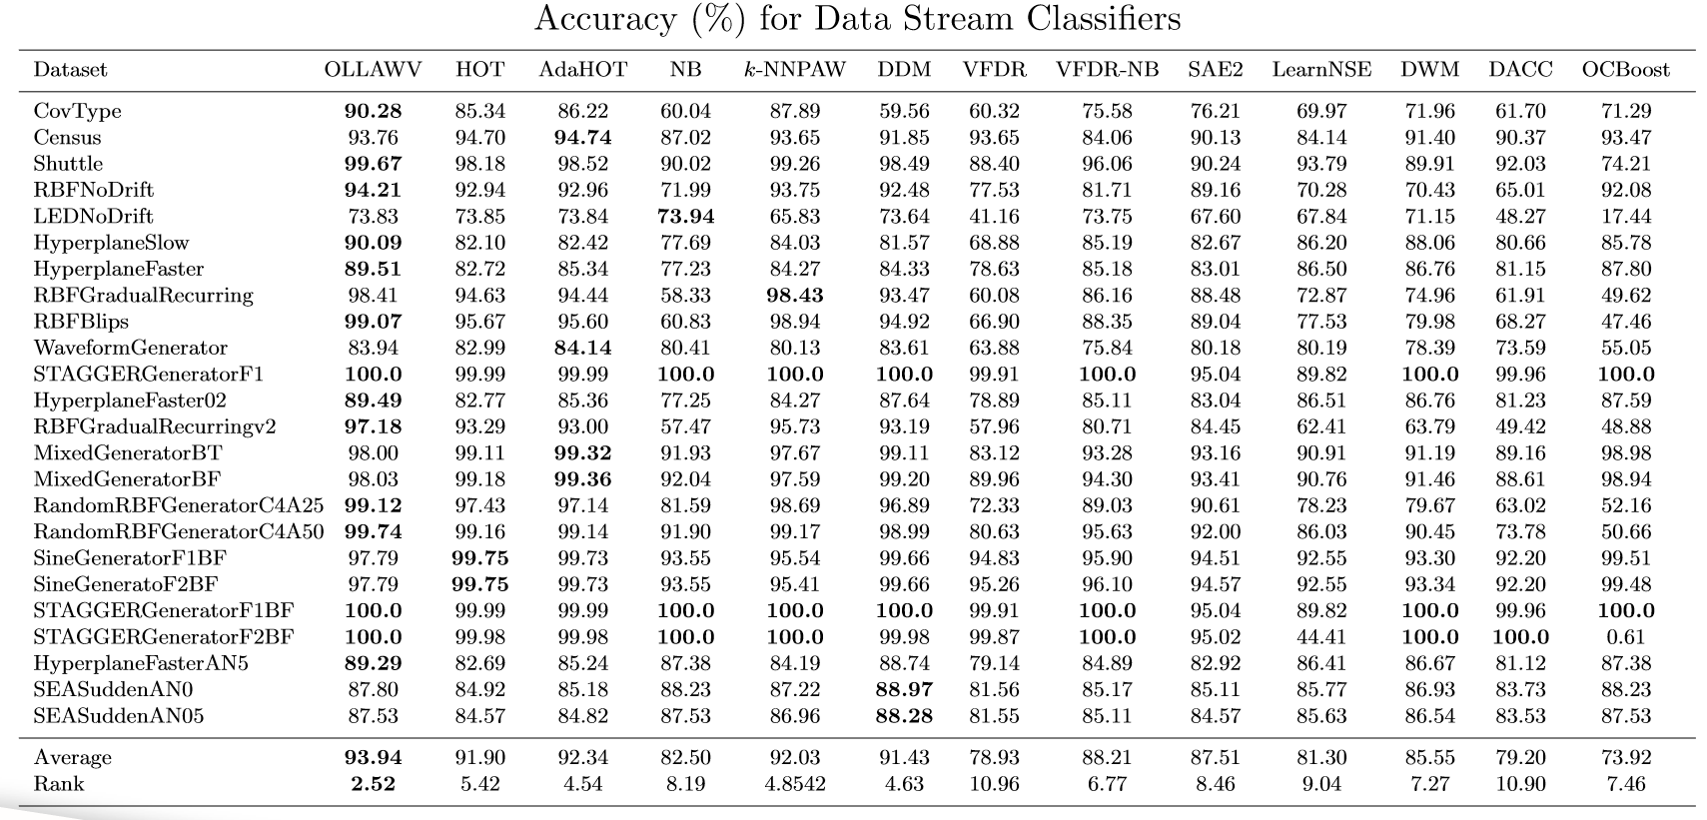
Results
Notes:
13 algorithms
OLLAWV:
is best for 14/24 datasets
competitive average over kNNPAW, AdaHOT, DDM, and HOT
Even competitive against methods with drift detectors – making it a good base-line algorithm
This is likely due to the method in which it updates – worst-violator
If a gradual drift occurs – more likely to be misclassified samples, which will be selected first to be updated
However, for sudden drifts – OLLAWV wouldn’t be able to update and adjust the model in time – as shown in SEA generator results.
------
Note: kNNPAW uses sliding window, AdaHOT & DDM use HOT as base classifier, which is why statistical test.

Slide 54
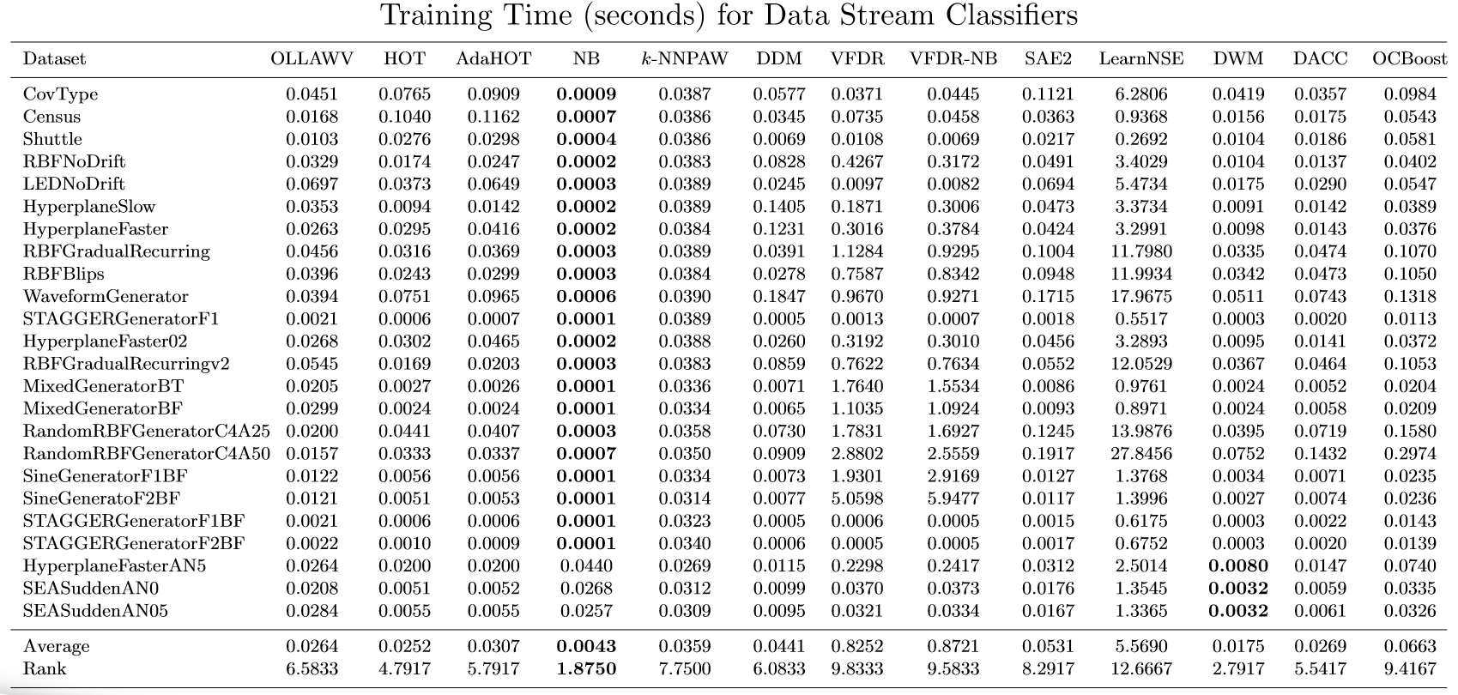
Results
Notes:
NB is fastest and ranked the first
Expected because simplest, however has poor performance in other metrics
DWM and HOT ranked next, however DWM accuracy were worse than competing methods
Without complementing performance results, fast training times are insignificant
Best performing ones were: OLLAWV, AdaHOT, DDM, kNNPAW, and HOT
OLLAWV better scalability than AdaHOT, DDM, and KNNPAW despite having to rebuild the classifier on each batch
Additionally, OLLAWV performs 5-fold CV for parameter selection, which is also expensive.
Despite these trains, still showed competitive training times, most probably due to its early stopping capability.
(also pairwise)

Slide 55
Data Stream Classification Conclusions
OLLA-L2
OLLAWV
✅ OnLine (i.e. stochastic) learning algorithms
✅ Produce accurate & sparse models
✅ simpler kernel calculation
❌ no stopping criterion
❌ less accurate than OLLAWV
❌ kernel calculation bottleneck
✅ implicit stopping criterion
✅ worst-violator update
Experimental study showed OLLAWV’s merit as a base classifier:
Batch data stream setting
Slower drifting streams
Notes:
Under the data stream classification paradigm, we developed 2 algorithms:
OLLAL2
OLLAWV

Slide 56
Conclusions & Future Work

Slide 57
Conclusions
Multiple-Target Regression - 3 unique approaches:
SVR: baseline problem transformation
✅ fast, accurate ❌ targets’ correlations
SVRRC: ensemble of random chains using SVR
✅ targets’ correlations somewhat exploited ❌ slow, random
SVRCC: maximally correlated chained model
✅ correlations exploited, faster run times ❌ uncorrelated targets
SVRCC provided the best results among the contributions and the methods compared.
Notes:
Multiple-Target Regression
Three unique approaches were proposed: the baseline problem transformation SVR, an ensemble of randomly generated chains using this base model SVRRC, and a maximally correlated chained model SVRCC.
SVRCC was shown to capture target correlations accurately, providing the best results among the contributions and against the methods compared.

Slide 58
Conclusions
Multiple-Instance Classification
MIRSVM: novel MI bag-level formulation and algorithm, with a bag-representative selector
✅ remedied class imbalance, fast convergence
❌ issues when limited number of bags, QP solver
Bag-level based and ensemble learners had the best performance
Instance-level based learners deemed as strongly biased and unstable classifiers
Notes:
Multiple-Instance Classification
A novel multiple-instance bag-level formulation and algorithm, dubbed MIRSVM, with a bag-representative selector, are proposed.
MIRSVM outperformed current contemporary SVM multi-instance algorithms, as well as other algorithms of different classes.

Slide 59
Conclusions
Traditional Classification
OLLAWV: novel online (stochastic) algorithm for the L1SVM problem + stopping criterion + worst-violator update
✅ ~2x faster than contemporary SVM solvers
✅ ~1.7x smaller (less complex) final model
✅ faster & less complex model without sacrificing accuracy
OLLAWV performed the best against 5 non-SVM algorithms
G. Melki et al. “OLLAWV: OnLine Learning Algorithm using Worst-Violators”. Applied Soft Computing, vol. 66, 384-393, 2018

Slide 60
Conclusions
Data Stream Classification
OLLA-L2: online algorithm with change detector
✅ fast update mechanism
❌ no stopping criterion
❌ less accurate than OLLAWV
OLLAWV: stochastic base algorithm (batched data streams)
✅ accuracy
✅ stopping criterion
⚠️ runtime
❌ does not accommodate abrupt drifting streams
Notes:
Issue with runtime
Parameter selection
Rebuilding entire model upon new batch arrival
Kernel vector calculation

Slide 61
Future Work
OLLAWV for the Multi-target Learning & Multi-Instance Learning paradigms:
Implement the existing contributions using OLLAWV
Extend OLLAWV to the regression case
Investigate OLLAWV’s performance under the Multi-Instance regression and Multi-Label classification settings

Slide 62
Future Work
OLLAWV for the Multi-target Learning & Multi-Instance Learning paradigms:
Implement the existing contributions using OLLAWV
Extend OLLAWV to the regression case
Investigate OLLAWV’s performance under the Multi-Instance regression and Multi-Label classification settings
OLLAWV & OLLA-L2 for the online Data Stream Learning paradigm:
Investigate stopping criteria for OLLA-L2
Explore merging favorable properties of OLLA-L2 and OLLAWV
Add functionality for handling non-stationary streams

Slide 63
Future Work
OLLAWV for the Multi-target Learning & Multi-Instance Learning paradigms:
Implement the existing contributions using OLLAWV
Extend OLLAWV to the regression case
Investigate OLLAWV’s performance under the Multi-Instance regression and Multi-Label classification settings
OLLAWV & OLLA-L2 for the online Data Stream Learning paradigm:
Investigate stopping criteria for OLLA-L2
Explore merging favorable properties of OLLA-L2 and OLLAWV
Add functionality for handling non-stationary streams
Parallelized/Distributed version of OLLAWV

Slide 64
Publications
[1] G. Melki, A. Cano, V. Kecman, and S. Ventura. “Multi-target support vector regression via correlation regressor chains”. Information Sciences, vol. 415-416, pp. 53–69, 2017.
Impact Factor: 4.305, Quartile: Q1
[2] G. Melki, A. Cano, and S. Ventura. “MIRSVM: Multi-Instance Support Vector Machine with Bag Representatives”. Pattern Recognition, vol. 79, pp. 228-241, 2018.
Impact Factor: 3.962, Quartile: Q1
[3] G. Melki, V. Kecman, S. Ventura, and A. Cano. “OLLAWV: OnLine Learning Algorithm using Worst-Violators”. Applied Soft Computing, vol. 66, pp. 384-393, 2018.
Impact Factor: 3.907, Quartile: Q1

Slide 65
Vita
G. Melki, V. Kecman, S. Ventura, and A. Cano. “OLLAWV: OnLine Learning Algorithm using Worst-Violators”. Applied Soft Computing, vol. 66, pp. 384-393, 2018.
G. Melki, A. Cano, and S. Ventura. “MIRSVM: Multi-Instance Support Vector Machine with Bag Representatives”. Pattern Recognition, vol. 79, pp. 228-241, 2018.
G. Melki, A. Cano, V. Kecman, and S. Ventura. “Multi-target support vector regression via correlation regressor chains”. Information Sciences, vol. 415-416, pp. 53–69, 2017.
G. Melki, Fast Online Training of L1 Support Vector Machines, Master's Thesis, Virginia Commonwealth University, 2016.
G. Melki, V. Kecman, Speeding Up Online Training of L1 Support Vector Machines, In: Proceedings of the IEEE SoutheastCon, 2016, pp. 1-6, 2016.
V. Kecman, G. Melki, Fast Online Algorithm for SVMs, In: Proceedings of the IEEE SoutheastCon, 2016, pp. 1-6, 2016.
V. Kecman, L. Zigiç, G. Melki, Models and Algorithms for Support Vector Machines: Direct L2 SVM, Seminar at Max Planck Institute for Intelligent Systems, Empirical Inference, Tübigen, Germany, 2015.

